Slide 1
CQA JUNE
Integrated Laboratory

Slide 2
 | DATE | 1 | 2 | 3 | 4 | 5 | 6 | 7 | 8 | 9 | 10 | 11 | 12 | 13 | 14 | 15 | 16 | 17 | 18 | 19 | 20 | 21 | 22 | 23 | 24 | 25 | 26 | 27 | 28 | 29 | 30 | TOTAL
POOL | CLINIC
JB A | BBU | - | - | - | 1 | - | - | - | - | - | - | - | - | - | - | - | - | - | - | - | - | - | - | - | - | - | - | - | - | - | - | 1
 | PANDAN | - | - | - | 1 | - | - |  | - | - | - |  | - | - | - | - | - | - | - |  | - | - | - | - | - |  | - | - | - | - | 1 | 2
 | P.WANGSA | - | - | - | - | - | - | - | - | - | - | - | - | - | - | - | - | - | - | - | - | - | - | - | - | - | - | - | - | - | - | 0
 | DAHLIA | - | - | - | - | - | - | - | - | - | - | - | - | - | - | - | - | - | - | - | - | - | - | - | - | - | - | - | - | - | - | 0
 | DAYA | - | - | - | - | - | - | - | - | - | - | - | - | - | - | - | - | - | - | - | - | - | - | - | - | - | - | - | - | - | - | 0
 | GAYA | - | - | - | - | - | - | - | - | - | - | - | - | - | - | - | - | - | - | - | - | - | - | - | - | - | - | - | - | - | - | 0
 | PERLING | - | - | - | - | - | - | - | - | - | - | - | - | - | - | - | - | - | - | - | - | - | - | - | - | - | - | - | - | - | - | 0
 | BAHAGIA | - | - | - | - | - | - | - | - | - | - | - | - | - | - | - | - | - | - | - | - | - | - | - | - | - | - | - | - | - | - | 0
JB B | SRI PULAI | - | - | - | - | - | - | - | - | - | - | - | - | - | - | - | - | - | - | 1 | 1 | - | - | - | - | - | - | - | - | - | - | 2
 | TMN U | - | - | - | - | 1 | - | - | - | - | - | - | - | - | - | - | - | - | - | - | - | - | - | - | - | - | - | - | - | - | - | 1
 | G.PATAH | - | - | - | - | - | - | - | - | - | - | - | - | - | - | - | - | - | - | - | - | - | - | - | - | - | - | - | - | - | - | 0
 | SENAI | - | - | - | - | - | 1 | - | - |  | - | - | - | - | - | - | - | - | - | - | - | - | - | - | - | - | - | - | - | - | - | 1
MASAI | MASAI | - | - | - | - | - | - | - | - | - | - |  | - | - | - | - | - | - | - | - | - | - | - | - | - | - | - | - | - | - | - | 0
 | P.GUDANG | - | - | - | - | - | - | - | - | - | - | - | - | - | - | - | - | - | - | - | - | - | - | - | - | - | - | - | - | - | - | 0
 | BETIK | - | - | - | - | - | - | - | - | - | - | - | - | - | - | 1 | - | - | - | - | - | - | - | - | - | - | - | - | - | - | - | 1
 | TEMBIKAI | - | - | - | - | - | - | - | - | - | - | - | - | - | - | - | - | - | - | - | - | - | - | - | - | - | - | - | - | - | - | 0
 | SDE | - | - | - | - | - | - | - | - | - | - | - | - | - | - | - | - | - | - | - | - | - | - | - | - | - | - | - | - | - | - | 0
 | MMHE | - | - | - | - | - | - | - | 1 | - | - | - | - | - | - | - | - | - | - | - | - | - | - | - | - | 1 | - | - | - | - | - | 2
 | T. RINTING | - | - | - | 1 | - | - | - | 1 | - | - | - | - | 1 |  | - | - | - | - | - | - | - | - | - | - | - | - | - | - | - | 13 | 16
K.TINGGI | K.TINGGI | - | - | - | - | - | - | - | - | - | - | - | - | - | - | - | - | - | - | - | - | - | - | - | - | - | - | - | - | - | - | 0
 | B.PENAWAR | - | - | - | - | - | - | - | - | - | - | - | - | - | - | - | - | - | - | - | - | - | - | - | - | - | - | - | - | - | - | 0
 | KLEDANG | - | - | - | - | - | - | - | - | - | - | - | - | - | - | - | - | - | - | - | - | - | - | - | - | - | - | - | - | - | - | 0
LAIN-LAIN | KULAI | - | - | - | - | - | - | - | - | - | - | - | - | - | - | - | - | - | - | - | - | - | - | - | - | - | - | - | - | - | - | 0
 | S.RENGGAM | - | - | - | - | - | - | - | - | - | - | - | - | - | - | - | - | - | - | - | - | - | - | - | - | - | - | - | - | - | - | 0
 | KLANG | - | - | - | - | - | - | - | - | - | - | - | - | - | - | - | - | - | - | - | - | - | - | - | - | - | - | - | - | - | - | 0

Slide 3
 |  | NON-COMPLIANCE
POOL | CLINIC | INCOMPLETE FORM | LATE/UNBILL PATIENT | WRONG TEST CODE | WRONG CONTAINER | DELAY SPECIMEN | TOTAL
JB A | BBU | 1 | 0 | 0 | 0 | 0 | 1
 | PANDAN | 2 | 0 | 0 | 0 | 0 | 2
 | P.WANGSA | 0 | 0 | 0 | 0 | 0 | 0
 | DAHLIA | 0 | 0 | 0 | 0 | 0 | 0
 | DAYA | 0 | 0 | 0 | 0 | 0 | 0
 | GAYA | 0 | 0 | 0 | 0 | 1 | 1
 | PERLING | 0 | 0 | 0 | 0 | 0 | 0
 | BAHAGIA | 0 | 0 | 0 | 0 | 0 | 0
JB B | SRI PULAI | 2 | 0 | 0 | 0 | 0 | 2
 | TMN U | 1 | 0 | 0 | 0 | 0 | 1
 | G.PATAH | 0 | 0 | 0 | 0 | 0 | 0
 | SENAI | 0 | 0 | 0 | 0 | 1 | 1
MASAI | MASAI | 0 | 0 | 0 | 0 | 0 | 0
 | P.GUDANG | 0 | 0 | 0 | 0 | 0 | 0
 | BETIK | 1 | 0 | 0 | 0 | 0 | 1
 | TEMBIKAI | 0 | 0 | 0 | 0 | 0 | 0
 | SDE | 0 | 0 | 0 | 0 | 0 | 0
 | MMHE | 1 | 1 | 0 | 0 | 0 | 2
 | TMN RINTING | 16 | 0 | 0 | 0 | 0 | 16
K.TINGGI | K.TINGGI | 0 | 0 | 0 | 0 | 0 | 0
 | B.PENAWAR | 0 | 0 | 0 | 0 | 0 | 0
 | KLEDANG | 0 | 0 | 0 | 0 | 0 | 0
LAIN-LAIN | KULAI | 0 | 0 | 0 | 0 | 0 | 0
 | S.RENGGAM | 0 | 0 | 0 | 0 | 0 | 0
 | KLANG | 0 | 0 | 0 | 0 | 0 | 0

Slide 4
CLINIC | APRIL | MAY | JUNE
BBU | 2 | 0 | 1
PANDAN | 23 | 9 | 2
P.WANGSA | 0 | 0 | 0
DAHLIA | 3 | 1 | 0
DAYA | 0 | 0 | 0
GAYA | 1 | 1 | 0
PERLING | 3 | 0 | 0
BAHAGIA | 1 | 1 | 0
SRI PULAI | 4 | 0 | 2
TMN U | 8 | 1 | 1
G.PATAH | 1 | 8 | 0
SENAI | 1 | 1 | 1
MASAI | 1 | 2 | 0
P.GUDANG | 6 | 3 | 0
BETIK | 6 | 1 | 1
TEMBIKAI | 1 | 3 | 0
SDE | 0 | 1 | 0
MMHE | 3 | 3 | 2
TMN RINTING | 12 | 4 | 16
K.TINGGI | 0 | 1 | 0
B.PENAWAR | 0 | 0 | 0
KLEDANG | 0 | 0 | 0
KULAI | 1 | 0 | 0
S.RENGGAM | 0 | 0 | 0

Slide 5
KESALAHAN
NAMA PESAKIT DALAM REQUEST FORM TIDAK SAMA DENGAN SAMPLE PESAKIT.
SALAH GUNA KOD BILLING (BILLING SYSTEM)
TERLUPA BILL PESAKIT
TEST DALAM REQUEST FORM TIDAK SAMA DENGAN BILLING
TIDAK REQUEST TEST TAMBAHAN DALAM REQUEST FORM
TIDAK PERIKSA SAMPLE DAN REQUEST FORM DENGAN TELITI
TERLUPA HANTAR SAMPLE KE LAB
TIDAK INFORM LAB JIKA ADA TEST YANG DOCTOR BATALKAN.
BARANG-BARANG KEGUNAAN KLINIK KEHABISAN STOCK.

Slide 6
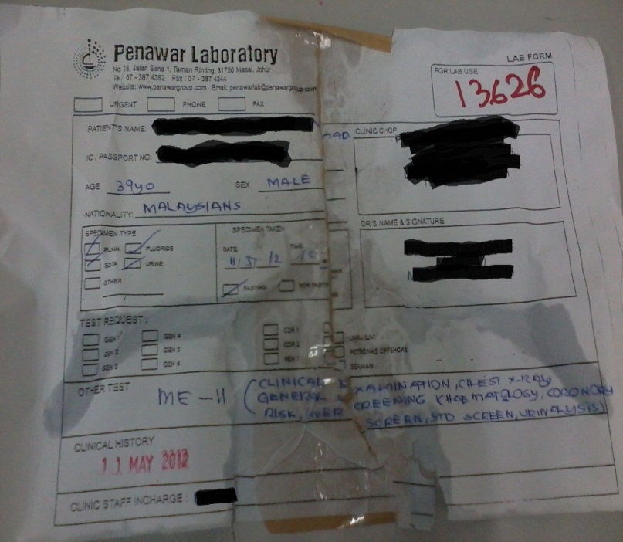
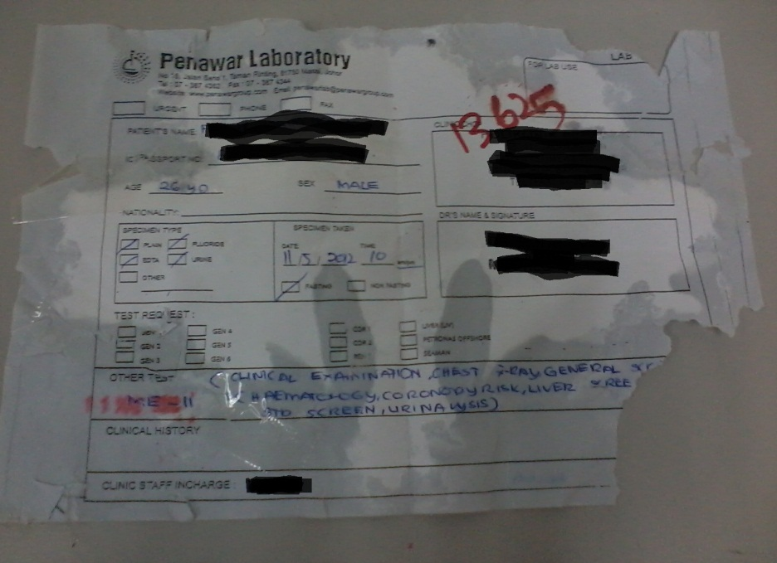
REQUEST FORM YANG BASAH
SELEPAS
SEBELUM

Slide 7
PENAWAR LAB REQUEST FORM

Slide 8
PRICELIST BOOK LAB
PENGGUNAAN KOD PL- ADALAH KOD YANG DIWARTAKAN OLEH PENAWAR LAB.
TIADA KOD LB- DIGUNAKAN
KOD ME- UNTUK MEDICAL CHECKUP
JANGAN BERPANDUKAN PADA BILLING SYSTEM SEMATA-MATA UNTUK BILL PESAKIT.
TANYA PIHAK LAB UNTUK MENCARI PACKAGE YANG SESUAI BAGI PESAKIT.

Slide 9
NOTIS DENDA
Bagi yang tidak charge pesakit/salah bill pesakit mengikut ujian yg diminta oleh doktor, pihak lab akan mengenakan penalti ke atas cawangan yang terlibat berdasarkan harga ujian yang lakukan di lab.

